Slide 1
The Approximate Duality Gap Technique and Applications
Jelena Diakonikolas
CS 726
Fall 2020

Slide 2

The Basic Problem and the Oracle Model
Convergence in function value:
First-order blackbox (oracle) model:

Slide 3
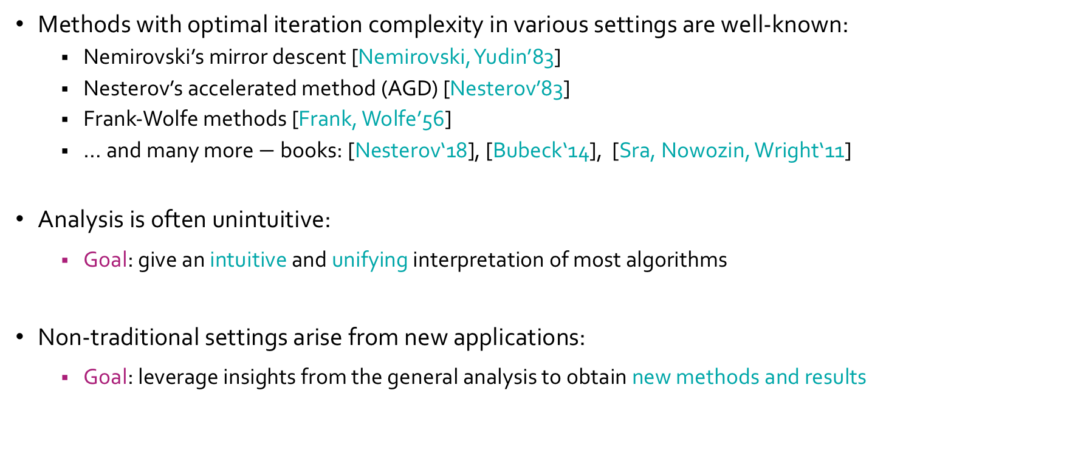
History and Why This Work
Methods with optimal iteration complexity in various settings are well-known:
Nemirovski’s mirror descent [Nemirovski, Yudin’83]
Nesterov’s accelerated method (AGD) [Nesterov’83]
Frank-Wolfe methods [Frank, Wolfe’56]
… and many more $−$ books: [Nesterov‘18], [Bubeck‘14], [Sra, Nowozin, Wright‘11]
Analysis is often unintuitive:
Goal: give an intuitive and unifying interpretation of most algorithms
Non-traditional settings arise from new applications:
Goal: leverage insights from the general analysis to obtain new methods and results

Slide 4
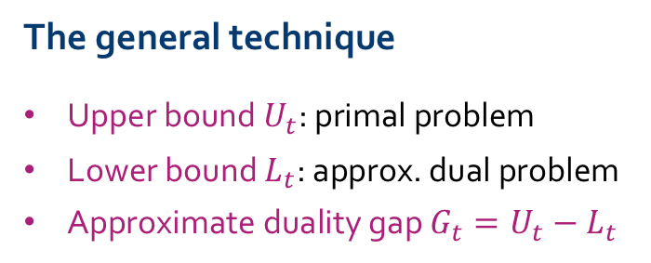
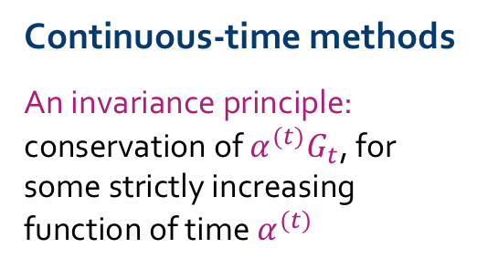
The Big Picture & Outline
The general technique
Upper bound $U_{t}$: primal problem
Lower bound $L_{t}$: approx. dual problem
Approximate duality gap $G_{t}=U_{t}−L_{t}$
Continuous-time methods
An invariance principle: conservation of $α^{(t)}G_{t}$, for some strictly increasing function of time $α^{(t)}$
Discrete-time methods
Discretization of continuous-time dynamics
Recovering known methods and obtaining new methods and results
Block Coordinate Descent
Optimization with relative error guarantees
Applications & Generalizations
(Local) acceleration & noise-corrupted gradients
“Newtonian view”:
“Lagrangian view”:
A Hamiltonian perspective and gradient norm minimization
[Nemirovski, Yudin’83], [Krichene, Bayen, Bartlett’15],
[Su, Boyd, Candes’14]
[Polyak’64],
[Attouch, Goudou, Redont’00],
[Wibisono, Wilson, Jordan’16], [Betancourt, Wilson, Jordan’18]
[D, Orecchia’17-’19]
[D, Jordan’19]

Slide 5
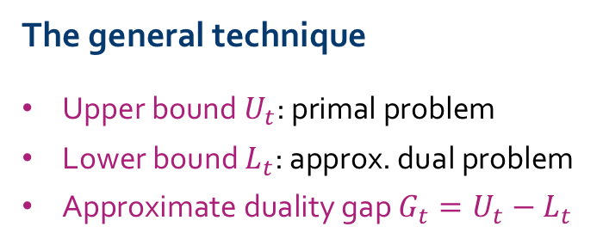
Outline
The general technique
Upper bound $U_{t}$: primal problem
Lower bound $L_{t}$: approx. dual problem
Approximate duality gap $G_{t}=U_{t}−L_{t}$
D, Orecchia, “The Approximate Duality Gap Technique: A Unified Theory of First-Order Methods,” SIAM J. Optimiz., 2019.

Slide 6



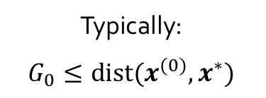
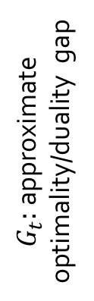
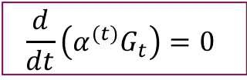
The General Idea
upper bound, $U_{t}$
optimality gap
$G_{t}:$approximate optimality/duality gap
lower bound, $L_{t}$
$f\left(x^{(t)}\right)−f\left(x^{∗}\right)≤G_{t}.$ Let $α^{(t)}$ be an increasing (rate) function of time $t$. Then, if $α^{(t)}G_{t}$ is conserved with time, i.e., if:
$$\frac{d}{dt}\left(α^{(t)}G_{t}\right)=0$$
Typically:
$$G_{0}≤dist(x^{(0)},x^{∗})$$
$$f\left(x^{(t)}\right)−f\left(x^{∗}\right)≤G_{t}=\frac{α^{(0)}G_{0}}{α^{(t)}}$$
then:

Slide 7


General Framework: Upper Bound
Typical choices:
convex combination of
Makes sense only if $f$is differentiable!
Makes sense because of Jensen’s Inequality:
Can differentiate $α_{t}U_{t}$ even if $f$is not differentiable!

Slide 8
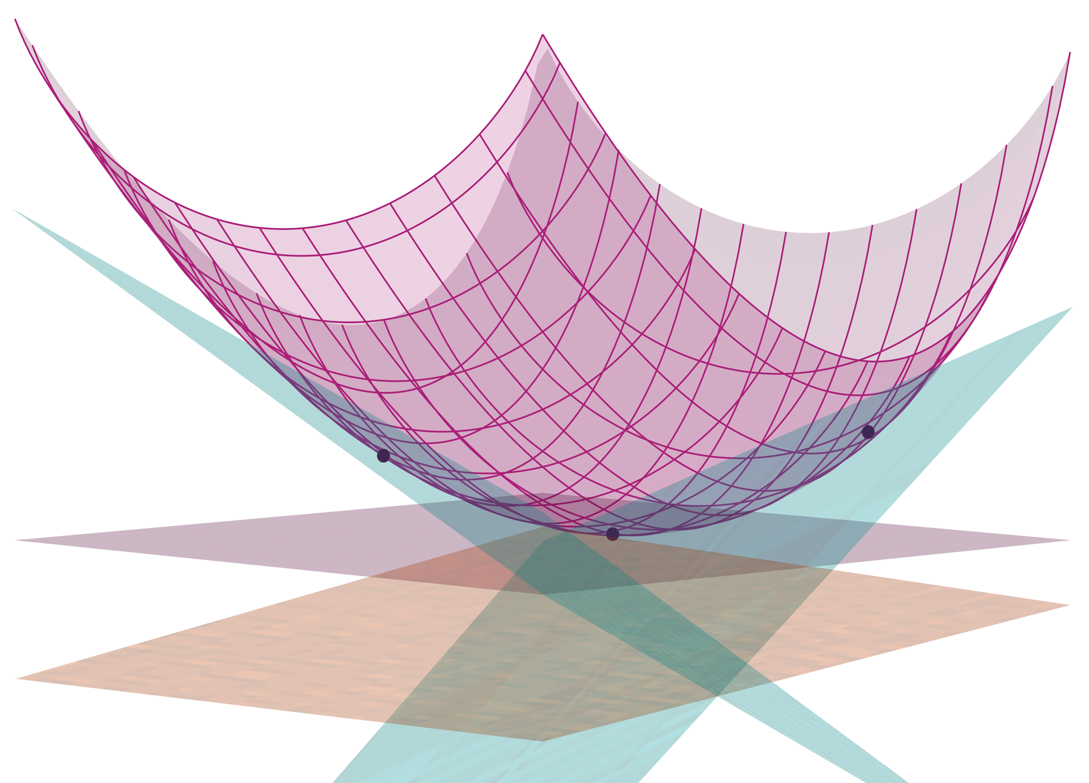
General Framework: Lower Bound
Suppose the algorithm constructs points
Each point defines a lower-bounding hyperplane
In particular:
Take the min on the right-hand side:
Not always a good idea: can change uncontrollably

Slide 9
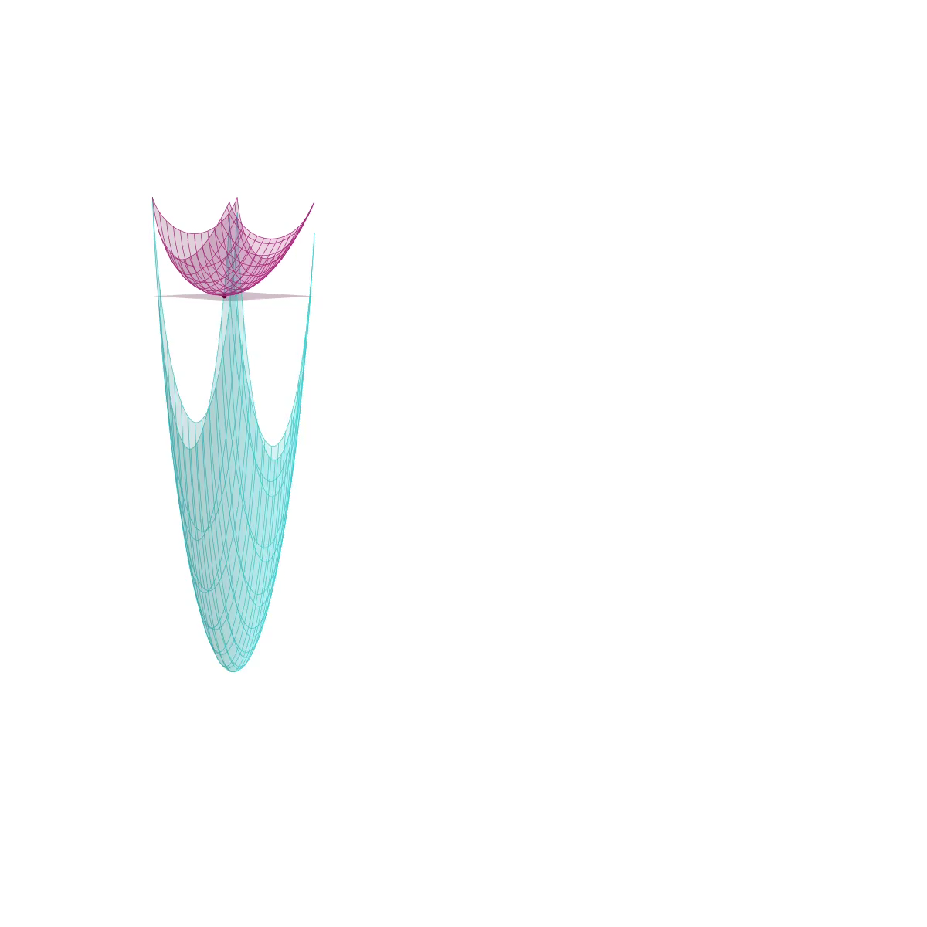
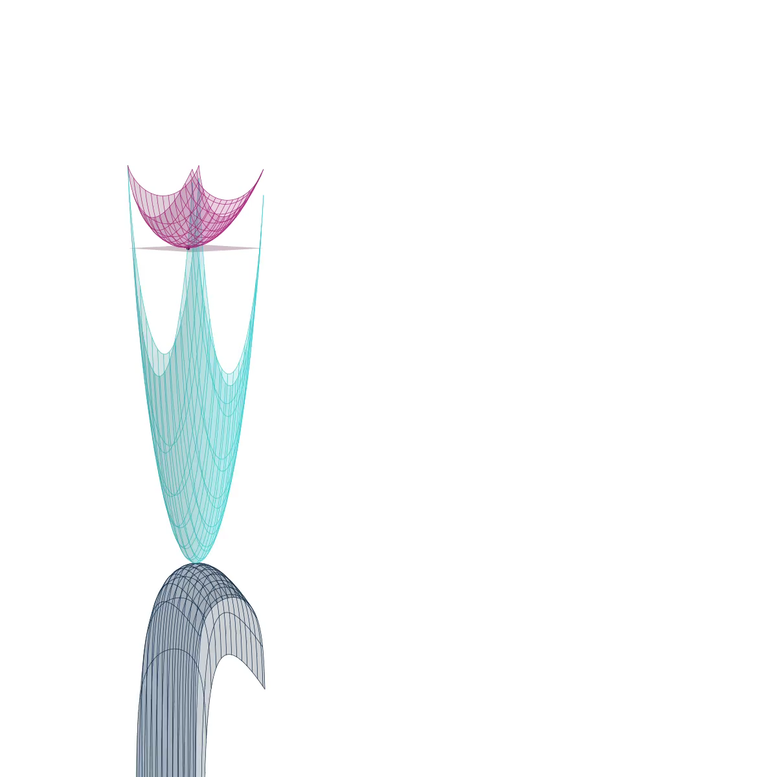
General Framework: Lower Bound
Regularization. Given strictly concave :
homotopy
Taking the minimum on the right-hand side:
Closely related to Nesterov’s estimate sequence
Fenchel dual

Slide 10

Outline
The general technique
Upper bound $U_{t}$: primal problem
Lower bound $L_{t}$: approx. dual problem
Approximate duality gap $G_{t}=U_{t}−L_{t}$
Continuous-time methods
An invariance principle: conservation of $α^{(t)}G_{t}$, for some strictly increasing function of time $α^{(t)}$
Invariance principle:

Slide 11
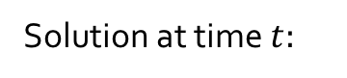
Continuous-Time Dual Averaging/Mirror Descent
Denote:
If , then:
A similar continuous-time dynamics was the motivation for the original mirror descent algorithm from [Nemirovskii, Yudin’83]
from the lower bound
Solution at time $t:$

Slide 12
Continuous-Time Accelerated Method
Denote:
If , then:
from the lower bound

Slide 13
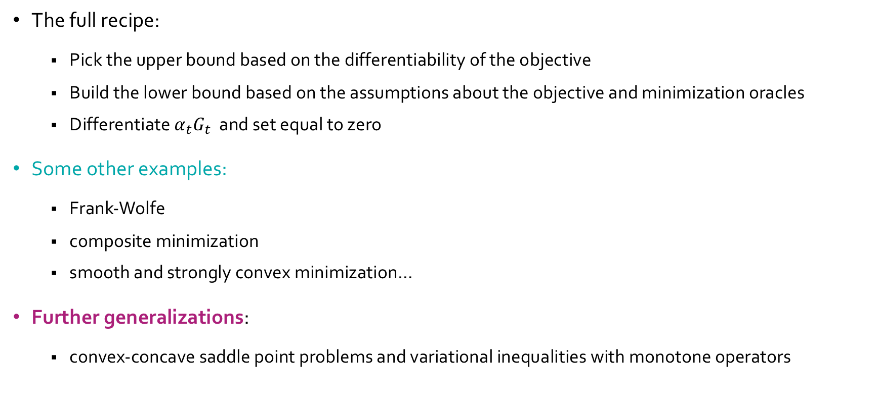
And Many More…
The full recipe:
Pick the upper bound based on the differentiability of the objective
Build the lower bound based on the assumptions about the objective and minimization oracles
Differentiate $α_{t}G_{t}$ and set equal to zero
Some other examples:
Frank-Wolfe
composite minimization
smooth and strongly convex minimization…
Further generalizations:
convex-concave saddle point problems and variational inequalities with monotone operators
D, Orecchia, “The Approximate Duality Gap Technique: A Unified Theory of First-Order Methods,” SIAM J. Optimiz., 2019.

Slide 14
Outline
The general technique
Upper bound $U_{t}$: primal problem
Lower bound $L_{t}$: approx. dual problem
Approximate duality gap $G_{t}=U_{t}−L_{t}$
Continuous-time methods
An invariance principle: conservation of $α^{(t)}G_{t}$, for some strictly increasing function of time $α^{(t)}$
Discrete-time methods
Discretization of continuous-time dynamics
Recovering known methods and obtaining new methods and results
Invariance principle:

Slide 15
Classical Euler Discretization Methods
Forward Euler discretization:
explicit!
Backward Euler discretization:
implicit!

Slide 16
Discretization of Accelerated Dynamics
Forward Euler discretization:
incurs positive discretization error in the gap!
(worse for convergence)
Nesterov’s Accelerated Method (AGD):
Correct discretization error by performing a gradient descent step
Backward Euler discretization:
incurs negative discretization error in the gap!
(better for convergence)
Accelerated Extra-Gradient Descent (AXGD)*:
Perform approximate Backward Euler step via two fixed-point iterations
Both algorithms have optimal iteration complexity for smooth convex objective functions!
*D, Orecchia, “Accelerated Extra-Gradient Descent: A Novel Accelerated First-Order Method,” in Proc ITCS’18, 2018

Slide 17
Refinement: AGD+
AXGD matches the worst-case performance of Nesterov’s AGD
Empirically, more robust to noise that AGD
However, uses twice as many gradients (2 x gradient oracle complexity)
Refinement:
Improved AGD (AGD+):
Similar to AXGD, but reuses gradients
Matches the oracle complexity of AGD
Still quite robust to noise, robustness can be analyzed
*Cohen, D, Orecchia, “On Acceleration with Noise-Corrupted Gradients,” in Proc. ICML’18, 2018

Slide 18
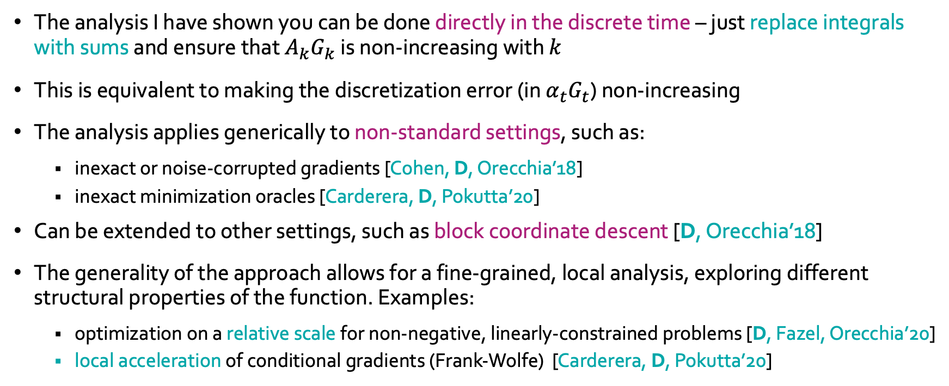
A Few Notes Regarding the Discrete-Time Methods
The analysis I have shown you can be done directly in the discrete time – just replace integrals with sums and ensure that $A_{k}G_{k}$is non-increasing with $k$
This is equivalent to making the discretization error (in $α_{t}G_{t}$) non-increasing
The analysis applies generically to non-standard settings, such as:
inexact or noise-corrupted gradients [Cohen, D, Orecchia’18]
inexact minimization oracles [Carderera, D, Pokutta’20]
Can be extended to other settings, such as block coordinate descent [D, Orecchia’18]
The generality of the approach allows for a fine-grained, local analysis, exploring different structural properties of the function. Examples:
optimization on a relative scale for non-negative, linearly-constrained problems [D, Fazel, Orecchia’20]
local acceleration of conditional gradients (Frank-Wolfe) [Carderera, D, Pokutta’20]

Slide 19
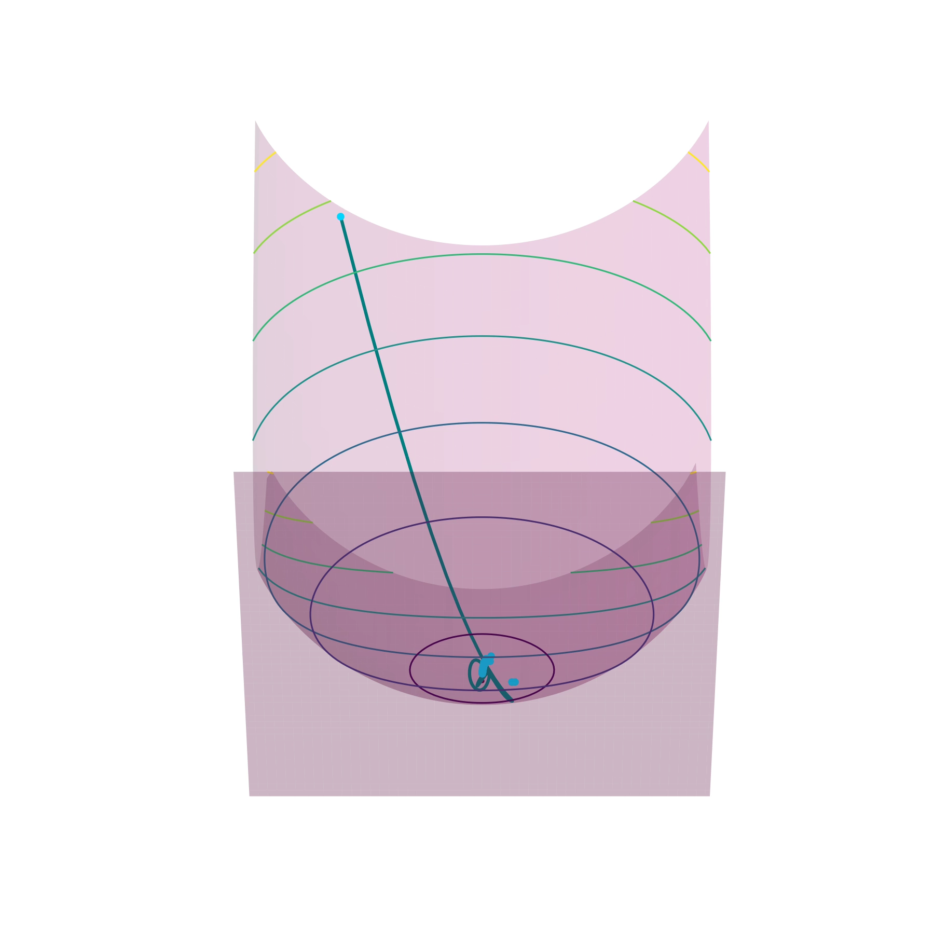

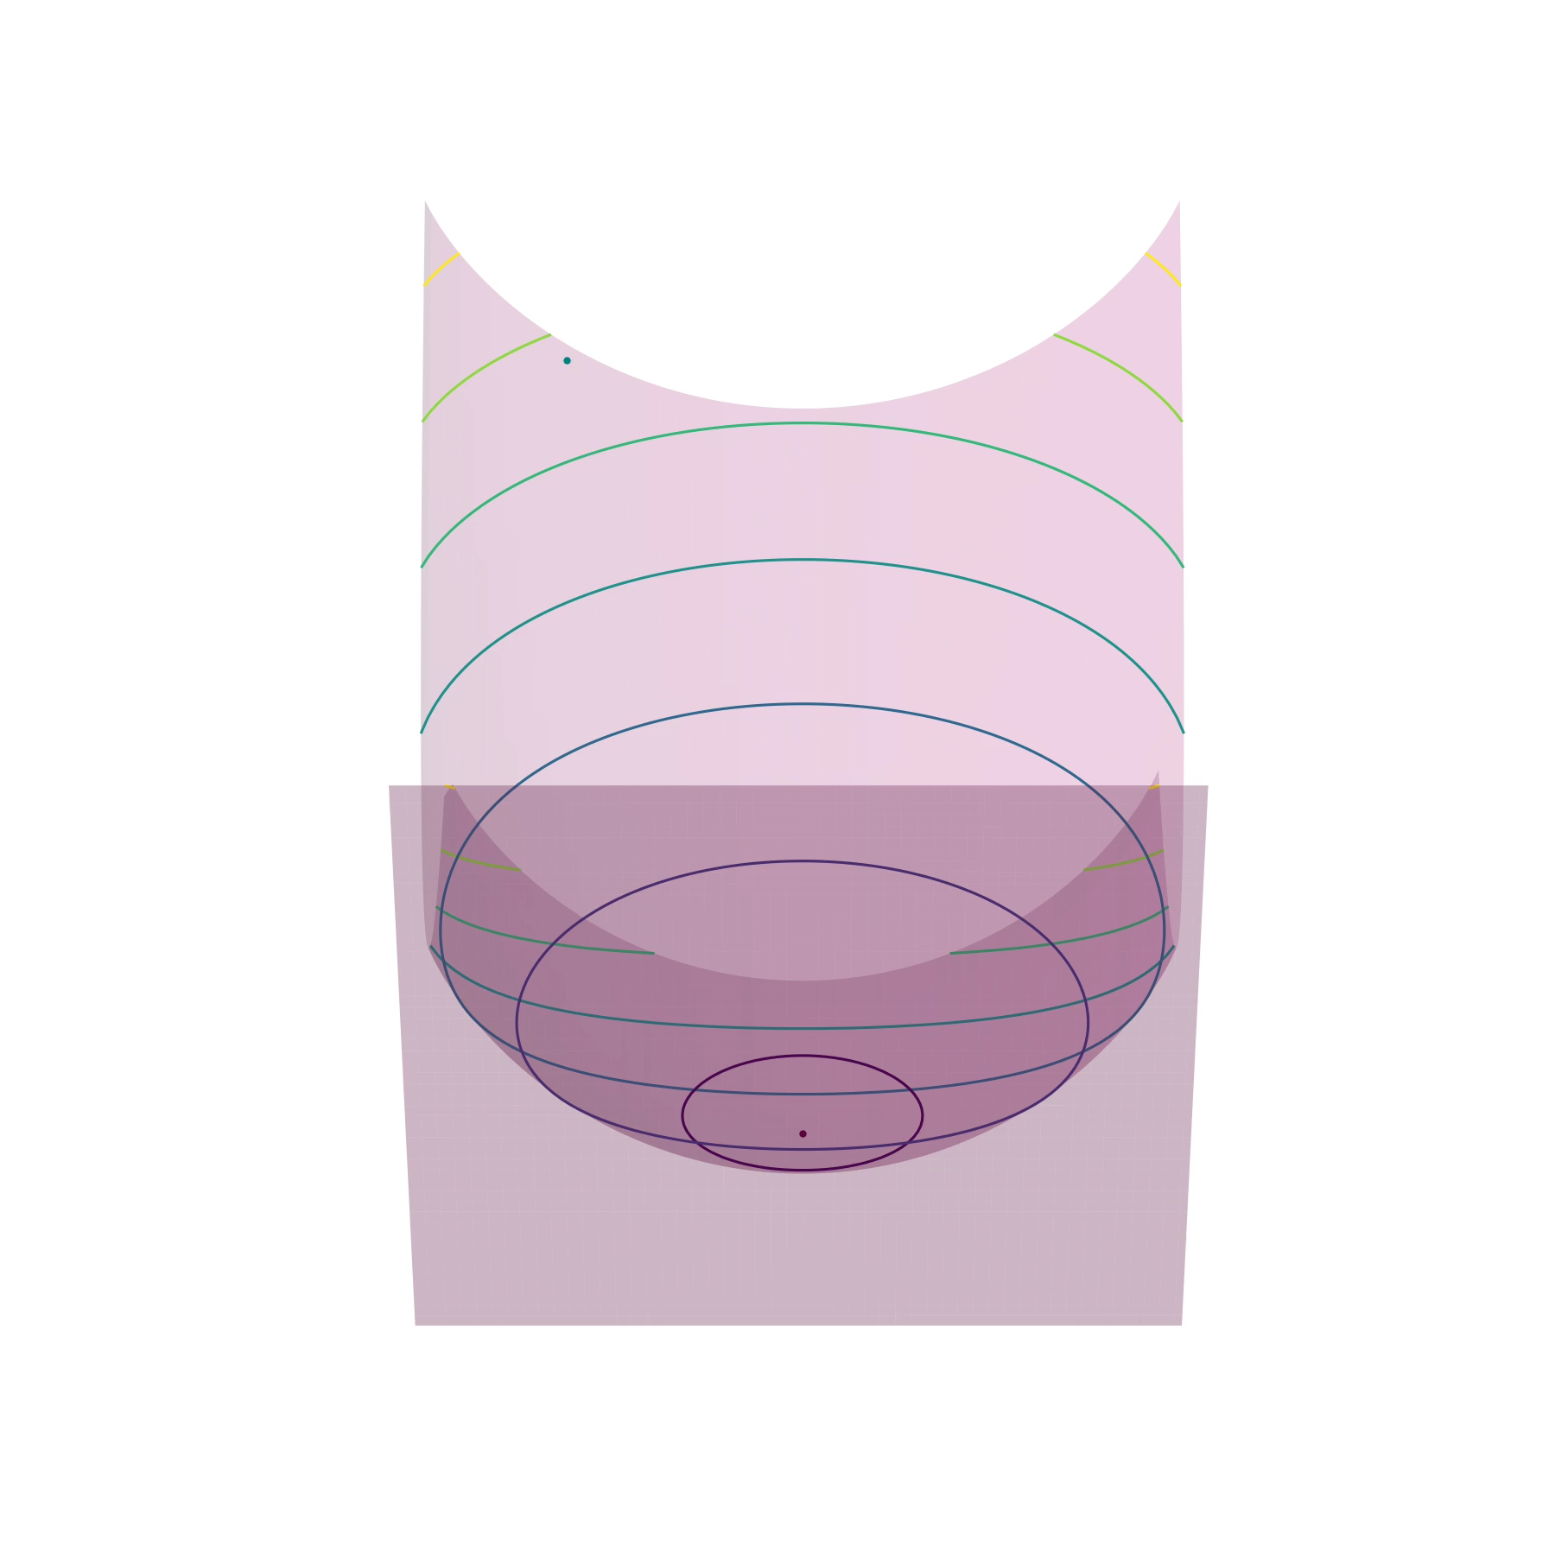

Illustration of the Algorithms
Continuous-time Accelerated Method
Nesterov’s AGD
Our work (AXGD)
Our work (AGD+)

Slide 20
Outline
The general technique
Upper bound $U_{t}$: primal problem
Lower bound $L_{t}$: approx. dual problem
Approximate duality gap $G_{t}=U_{t}−L_{t}$
Continuous-time methods
An invariance principle: conservation of $α^{(t)}G_{t}$, for some strictly increasing function of time $α^{(t)}$
Discrete-time methods
Discretization of continuous-time dynamics
Recovering known methods and obtaining new methods and results
Block Coordinate Descent
Optimization with relative error guarantees
Applications & Generalizations
(Local) acceleration & noise-corrupted gradients
Invariance principle:

Slide 21
Locally-Accelerated Conditional Gradients

Slide 22
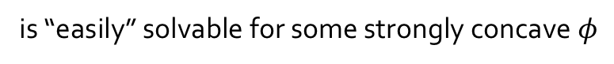
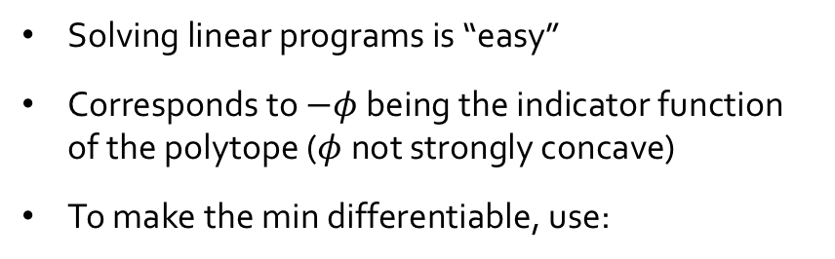
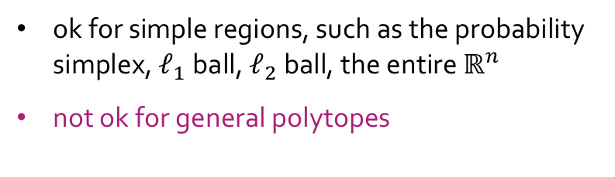
Projections & Projection-Free Methods
An assumption we made in the lower bound:
What do for polytopes?
Solving linear programs is “easy”
Corresponds to $−φ$ being the indicator function of the polytope ($φ$not strongly concave)
To make the min differentiable, use:
is “easily” solvable for some strongly concave $φ$
ok for simple regions, such as the probability simplex, $ℓ_{1}$ ball, $ℓ_{2}$ ball, the entire $ℝ^{n}$
not ok for general polytopes
Conditional gradients (Frank-Wolfe) methods use convex combinations of these minimizers
(projection free!)

Slide 23
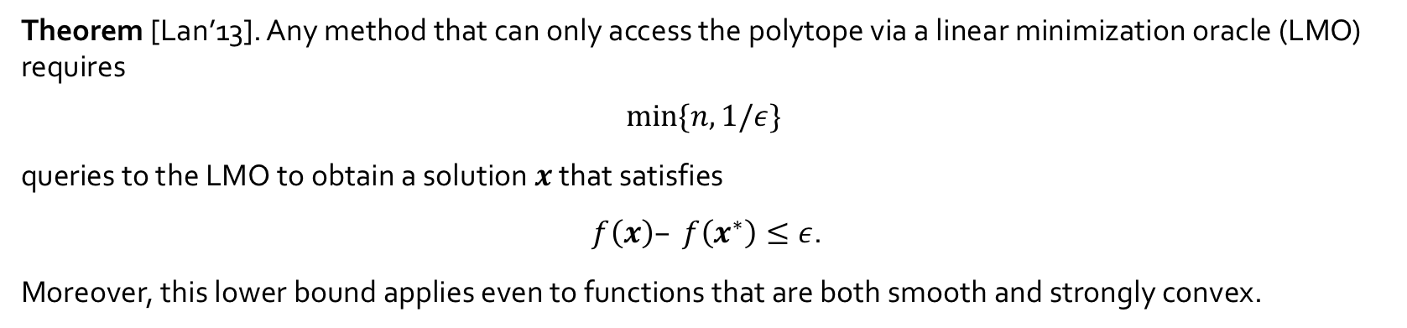
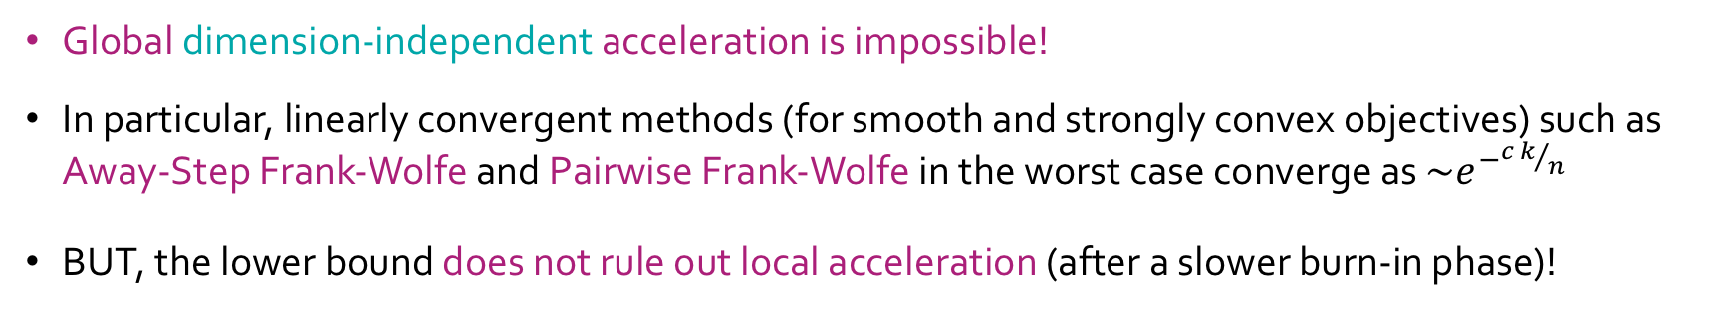
Limitations to Global Acceleration
Theorem [Lan’13]. Any method that can only access the polytope via a linear minimization oracle (LMO) requires
$$min⁡\{n, 1/ε\}$$
queries to the LMO to obtain a solution $x$ that satisfies
$f\left(x\right)– f\left(x^{∗}\right)≤ε$.
Moreover, this lower bound applies even to functions that are both smooth and strongly convex.
Global dimension-independent acceleration is impossible!
In particular, linearly convergent methods (for smooth and strongly convex objectives) such as Away-Step Frank-Wolfe and Pairwise Frank-Wolfe in the worst case converge as ${\sim e}^{−{c k}/n}$
BUT, the lower bound does not rule out local acceleration (after a slower burn-in phase)!

Slide 24
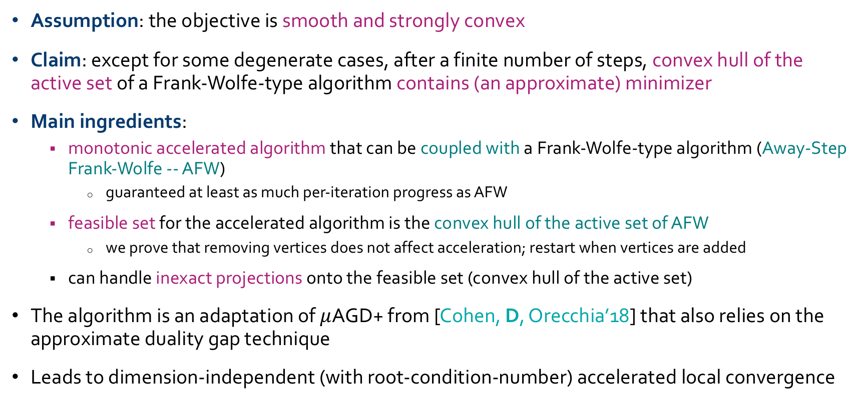
Local Acceleration: Main Ideas
Assumption: the objective is smooth and strongly convex
Claim: except for some degenerate cases, after a finite number of steps, convex hull of the active set of a Frank-Wolfe-type algorithm contains (an approximate) minimizer
Main ingredients:
monotonic accelerated algorithm that can be coupled with a Frank-Wolfe-type algorithm (Away-Step Frank-Wolfe -- AFW)
guaranteed at least as much per-iteration progress as AFW
feasible set for the accelerated algorithm is the convex hull of the active set of AFW
we prove that removing vertices does not affect acceleration; restart when vertices are added
can handle inexact projections onto the feasible set (convex hull of the active set)
The algorithm is an adaptation of $μ$AGD+ from [Cohen, D, Orecchia’18] that also relies on the approximate duality gap technique
Leads to dimension-independent (with root-condition-number) accelerated local convergence
Carderera, D, Pokutta, “Locally Accelerated Conditional Gradients,” in Proc. AISTATS’20, 2020.

Slide 25
Numerical Results
Quadratic with condition # = 100 on a simplex of size 1,000:
Quadratic with a condition # = 100 on a Birkhoff polytope with 20 nodes (ambient dim. 400):

Slide 26
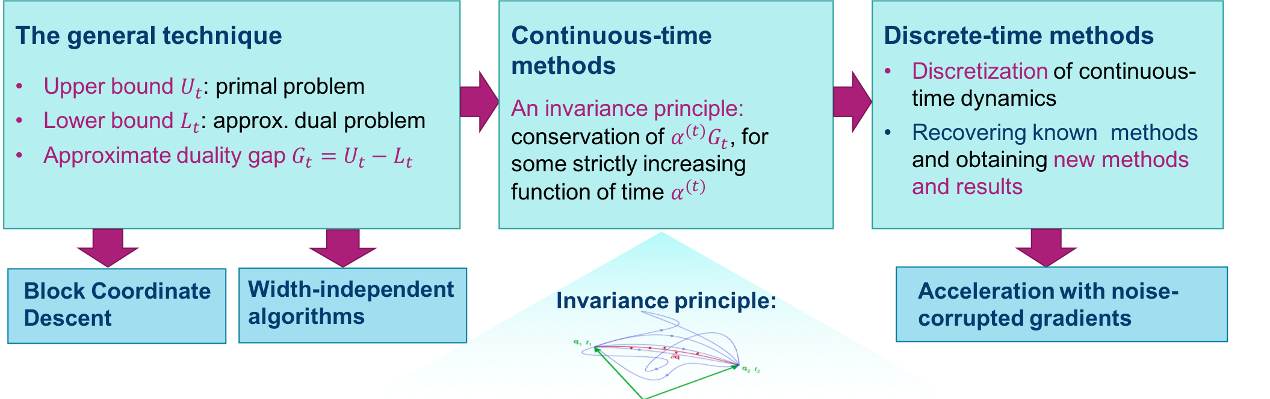
Summary
jelena@jelena-diakonikolas.com
www.jelena-diakonikolas.com
Thank you!

